Slide 1

University Institute of Engineering
DEPARTMENT OF COMPUTER SCIENCE & ENGINEERING
Bachelor of Engineering (Computer Science & Engineering)
Subject Name : Machine Learning
Subject Code: CST-316
Topic: Decision Tree
Lecture-2.5
By : Er.Baljeet Kaur Nagra
DISCOVER . LEARN . EMPOWER

Slide 2
Course Outcomes
CO-1:Apply the basic concept of Machine learning and statistics learning to deal with real-life Problems.
CO-2: Understand different machine learning algorithms, as well as underlying theories the behind them.
CO-3: Select and apply the appropriate machine learning algorithm to solve problems of moderate complexity
CO-4: Interpret and evaluate models generated from data.
CO-5: Optimize the models learned and report on the expected accuracy that can be attained by applying the algorithms to a real-world problem.

Slide 3
Course Objectives
To understand the history and development of Machine Learning.
To provide a comprehensive foundation to Machine Learning and Optimization methodology with applications t.
To study learning processes: supervised and unsupervised, deterministic and statistical knowledge of Machine learners, and ensemble learning
To understand modern techniques and practical trends of Machine learning.

Slide 4
CONTENTS
Decision Tree
Terminology
Applications
Working
Types
Algorithm
Assumptions
Regression vs Classifications
Strength
Weakness
Example

Slide 5
Decision Tree
A decision tree is a decision support tool that uses a tree-like graph or model of decisions and their possible consequences, including chance event outcomes, resource costs, and utility.
It is one way to display an algorithm that only contains conditional control statements.
A decision tree is a flowchart-like structure in which each internal node represents a “test” on an attribute (e.g. whether a coin flip comes up heads or tails), each branch represents the outcome of the test, and each leaf node represents a class label (decision taken after computing all attributes).
The paths from root to leaf represent classification rules.

Slide 6
Decision Tree-CART
Tree based learning algorithms are considered to be one of the best and mostly used supervised learning methods.
Tree based methods empower predictive models with high accuracy, stability and ease of interpretation.
Unlike linear models, they map non-linear relationships quite well.
They are adaptable at solving any kind of problem at hand (classification or regression).
Decision Tree algorithms are referred to as CART (Classification and Regression Trees).
“The possible solutions to a given problem emerge as the leaves of a tree, each node representing a point of deliberation and decision.”

Slide 7
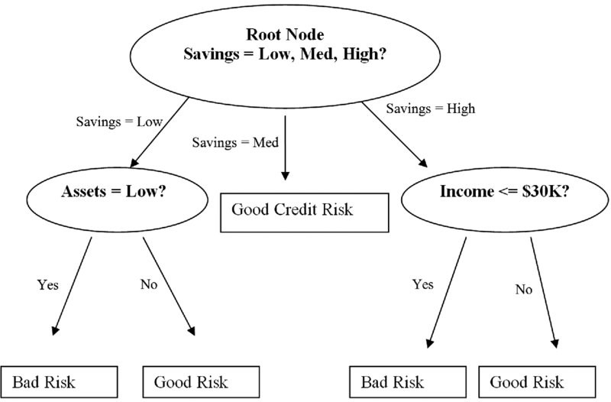
Decision Tree

Slide 8
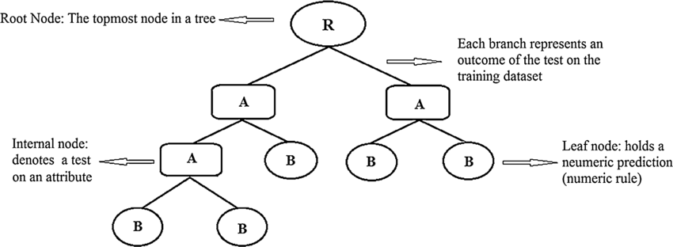
Decision Tree

Slide 9
Terminology
Root Node: It represents entire population or sample and this further gets divided into two or more homogeneous sets.
Splitting: It is a process of dividing a node into two or more sub-nodes.
Decision Node: When a sub-node splits into further sub-nodes, then it is called decision node.
Leaf/ Terminal Node: Nodes do not split is called Leaf or Terminal node.
Pruning: When we remove sub-nodes of a decision node, this process is called pruning. You can say opposite process of splitting.
Branch / Sub-Tree: A sub section of entire tree is called branch or sub-tree.
Parent and Child Node: A node, which is divided into sub-nodes is called parent node of sub-nodes whereas sub-nodes are the child of parent node.

Slide 10
Application
Decision trees have a natural “if … then … else …” construction that makes it fit easily into a programmatic structure.
They also are well suited to categorization problems where attributes or features are systematically checked to determine a final category.
For example, a decision tree could be used effectively to determine the species of an animal.
Because of their simplicity, tree diagrams have been used in a broad range of industries and disciplines including civil planning, energy, financial, engineering, healthcare, pharmaceutical, education, law, and business.

Slide 11
Applications
Evaluation of brand expansion opportunities for a business using historical sales data
· Determination of likely buyers of a product using demographic data to enable targeting of limited advertisement budget
· Prediction of likelihood of default for applicant borrowers using predictive models generated from historical data
· Help with prioritization of emergency room patient treatment using a predictive model based on factors such as age, blood pressure, gender, location and severity of pain, and other measurements
· Decision trees are commonly used in operations research, specifically in decision analysis, to help identify a strategy most likely to reach a goal.

Slide 12
Working
Decision tree is a type of supervised learning algorithm (having a pre-defined target variable) that is mostly used in classification problems.
It works for both categorical and continuous input and output variables.
In this technique, we split the population or sample into two or more homogeneous sets (or sub-populations) based on most significant splitter / differentiator in input variables.

Slide 13
Example
A tree can be “learned” by splitting the source set into subsets based on an attribute value test.
This process is repeated on each derived subset in a recursive manner called recursive partitioning.
The recursion is completed when the subset at a node all has the same value of the target variable, or when splitting no longer adds value to the predictions.
The construction of decision tree classifier does not require any domain knowledge or parameter setting, and therefore is appropriate for exploratory knowledge discovery.
Decision trees can handle high dimensional data. In general decision tree classifier has good accuracy.
Decision tree induction is a typical inductive approach to learn knowledge on classification.

Slide 14
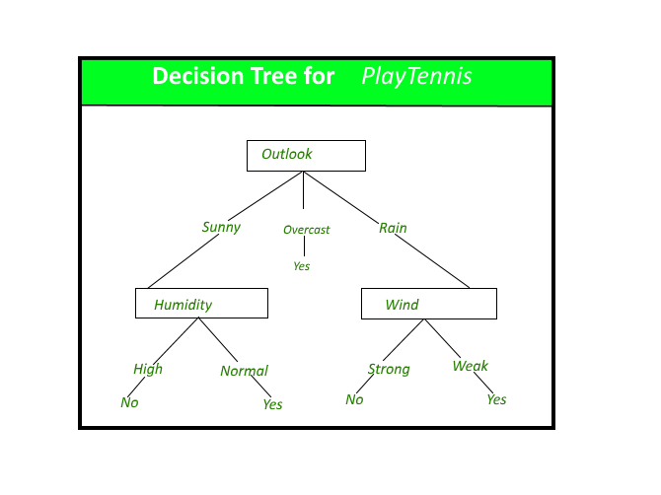
Example
Decision tree identifies the most significant variable and its value that gives best homogeneous sets of population. To identify the variable and the split, decision tree uses various algorithms.
The decision tree in above figure classifies a particular morning according to whether it is suitable for playing tennis and returning the classification associated with the particular leaf.(in this case Yes or No).

Slide 15
Types
Types of decision tree is based on the type of target variable we have.
It can be of two types:
Categorical Variable Decision Tree: Decision Tree which has categorical target variable then it called as categorical variable decision tree.
E.g.:- In above scenario classifies a particular morning according to whether it is suitable for playing tennis i.e. YES or NO.
Continuous Variable Decision Tree: Decision Tree has continuous target variable then it is called as Continuous Variable Decision Tree.
E.g.:- Let’s say we have a problem to predict whether a customer will pay his renewal premium with an insurance company (yes/ no). Here we know that income of customer is a significant variable but insurance company does not have income details for all customers. Now, as we know this is an important variable, then we can build a decision tree to predict customer income based on occupation, product and various other variables. In this case, we are predicting values for continuous variable.

Slide 16
Algorithm
The decision tree algorithm tries to solve the problem, by using tree representation. Each internal node of the tree corresponds to an attribute, and each leaf node corresponds to a class label.
Place the best attribute of the dataset at the root of the tree.
Split the training set into subsets. Subsets should be made in such a way that each subset contains data with the same value for an attribute.
Repeat step 1 and step 2 on each subset until you find leaf nodes in all the branches of the tree.

Slide 17
Algorithm
In decision trees, for predicting a class label for a record we start from the root of the tree.
We compare the values of the root attribute with record’s attribute.
On the basis of comparison, we follow the branch corresponding to that value and jump to the next node.
We continue comparing our record’s attribute values with other internal nodes of the tree until we reach a leaf node with predicted class value.
The modeled decision tree can be used to predict the target class or the value.

Slide 18
Assumptions
Some of the assumptions we make while using Decision tree:
At the beginning, the whole training set is considered as the root.
Feature values are preferred to be categorical. If the values are continuous then they are discretized prior to building the model.
Records are distributed recursively on the basis of attribute values.
Order to placing attributes as root or internal node of the tree is done by using some statistical approach

Slide 19
Regression Tree vs Classification Tree
Regression trees are used when dependent variable is continuous. Classification Trees are used when dependent variable is categorical.
In case of Regression Tree, the value obtained by terminal nodes in the training data is the mean response of observation falling in that region. Thus, if an unseen data observation falls in that region, we’ll make its prediction with mean value.
In case of Classification Tree, the value (class) obtained by terminal node in the training data is the mode of observations falling in that region. Thus, if an unseen data observation falls in that region, we’ll make its prediction with mode value.
Both the trees divide the predictor space (independent variables) into distinct and non-overlapping regions.

Slide 20
Regression Tree vs Classification Tree
Both the trees follow a top-down greedy approach known as recursive binary splitting. We call it as ‘top-down’ because it begins from the top of tree when all the observations are available in a single region and successively splits the predictor space into two new branches down the tree. It is known as ‘greedy’ because, the algorithm cares (looks for best variable available) about only the current split, and not about future splits which will lead to a better tree.
This splitting process is continued until a user defined stopping criteria is reached. For e.g.: we can tell the algorithm to stop once the number of observations per node becomes less than 50.
In both the cases, the splitting process results in fully grown trees until the stopping criteria is reached. But, the fully grown tree is likely to over fit data, leading to poor accuracy on unseen data. This bring ‘pruning’. Pruning is one of the technique used tackle overfitting.

Slide 21
Strength
The strengths of decision tree methods are:
Decision trees are able to generate understandable rules.
Decision trees perform classification without requiring much computation.
Decision trees are able to handle both continuous and categorical variables.
Decision trees provide a clear indication of which fields are most important for prediction or classification.

Slide 22
Weakness
Decision trees are less appropriate for estimation tasks where the goal is to predict the value of a continuous attribute.
Decision trees are prone to errors in classification problems with many class and relatively small number of training examples.
Decision tree can be computationally expensive to train.
The process of growing a decision tree is computationally expensive.
At each node, each candidate splitting field must be sorted before its best split can be found.
In some algorithms, combinations of fields are used and a search must be made for optimal combining weights.
Pruning algorithms can also be expensive since many candidate sub-trees must be formed and compared.

Slide 23
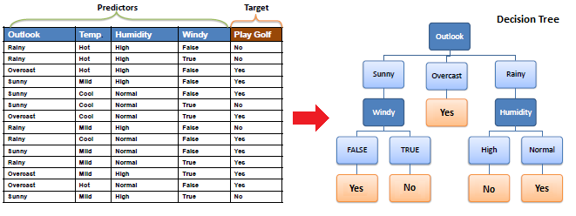
Example

Slide 24
References
Books and Journals
Understanding Machine Learning: From Theory to Algorithms by Shai Shalev-Shwartz and Shai Ben-David-Cambridge University Press 2014
Introduction to machine Learning – the Wikipedia Guide by Osman Omer.
Video Link-
https://www.youtube.com/watch?v=9f-GarcDY58
https://www.youtube.com/watch?v=GwIo3gDZCVQ
Web Link-
https://medium.com/greyatom/decision-trees-a-simple-way-to-visualize-a-decision-dc506a403aeb#:~:text=A%20decision%20tree%20is%20a%20flowchart%2Dlike%20structure%20in%20which,taken%20after%20computing%20all%20attributes).
https://www.geeksforgeeks.org/decision-tree/
https://towardsdatascience.com/decision-trees-in-machine-learning-641b9c4e8052

Slide 25
THANK YOU

